Slide 1
Distributed Control and Automation Framework (DCAF)
Components
Benjamin Celis, Mathew Pollock, Simon Perez

Slide 2
Agenda
The Tag Bus
Engine Architecture
Module Architectures
The Configuration Editor Framework

Slide 3
DCAF Components
Project Templates
Configuration
Runtime
Templates
Configuration Editor
Engine
Examples
Modules
Notes:
From DevGuide
**Engine**: State machine that executes *Modules* as defined in the *Configuration Editor* and provides a namespace for *Tags*. The Engine also passes data between its *Modules* according to its *Mappings*.
**Module**: A collection of code of varying functionality that executes within an *Engine* and that can interact with the *Tags* of that *Engine*. Some standard *Modules* are installed with DCAF, but users can also create their own.
**Configuration Editor**: A LabVIEW program used to visually define the functionality of each *Engine* and *Module* in DCAF.

Slide 4
Tag Bus

Slide 5
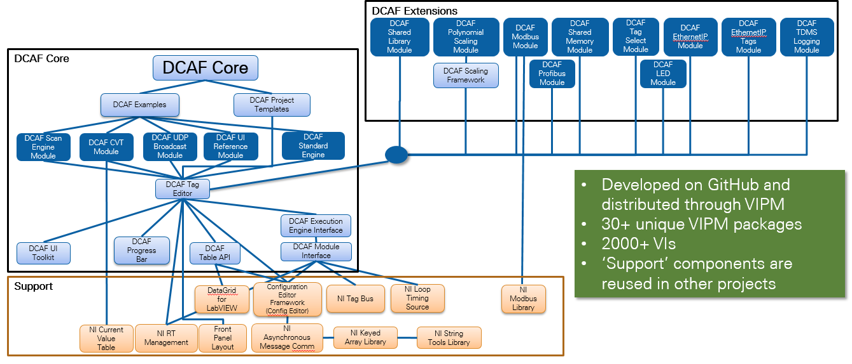
DCAF Package Dependency Diagram
Notes:
Useful for navigating Tools Network packages and GitHub Repos
The largest open source LabVIEW development project

Slide 6
Tag Bus
Current Options
Local Variable
Global Variable
Single
Functional Global Variable
Current Value Table (CVT)
Requirements
Flexibility
Scope
Performance
Notes:
DCAF was designed for systems in which the main data transfer is tags.
LabVIEW offers many options to manage tags.
But for design we had 3 main guidelines and they could not be achieved with the current options.
What's the need?
Limited Solutions:
Variables
CVT
Scope
Data Types

Slide 7

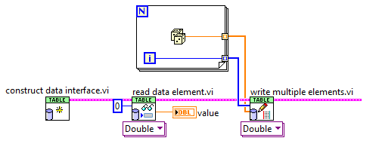
Tag Bus
CVT on the wire
Controlled Scope
Data Protection
Fast
Reduced memory copies
Filtering

Slide 8
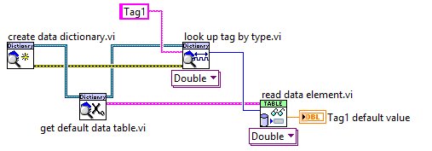
Tag Bus - Data Dictionary

Slide 9
Tag Bus
CVT on the wire
Controlled Scope
Data Protection
Fast
Reduced memory copies
Filtering

Slide 10
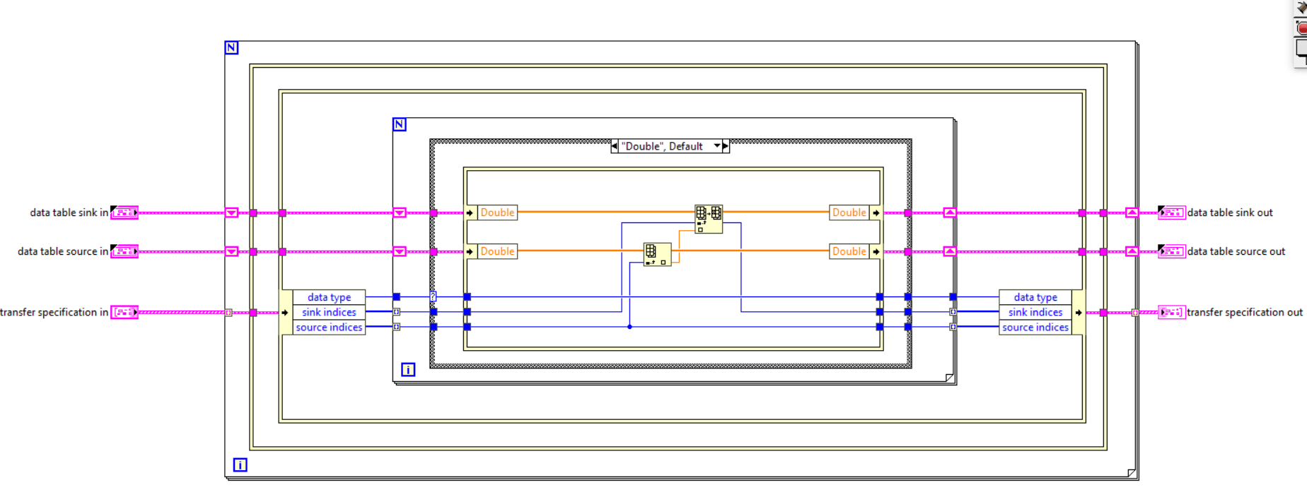
Tag Bus - Duplication
Notes:
Major issue with clustersauruses: data copies of the cluster and accidentally stomping on data, especially if sending the whole cluster into every user of the cluster
Solution: break up the cluster such that each user of the cluster gets the minimum data set it needs and prevent useless data copies when getting/setting the values from the main cluster
Each DCAF module gets a “mini” tag bus containing only the data used by that module. Scripting templates take care of all data access operations on the mini-tag bus in the module for most common use cases.
Use of in-place operations, plus never branching the main tag bus wire, prevent copies of the main cluster

Slide 11
Engine

Slide 12
DCAF Engine
Engine
Init
Input
Process
Output
Close
Input
Process
Output
Input
Process
Output
Outside
Outside?
Outside
Editor
Engine
Modules
Notes:
The DCAF Engine takes care of initiailizing, running and closing the modules set up by the Editor. Each module will have an Init, some kind of runtime behavior (Input, Process, Output, or some combination thereof) and Close.
Note that the Input modules are al called first, then all the process modules, and finally all the output modules. Let’s look at a simplified version of what the engine is running

Slide 13
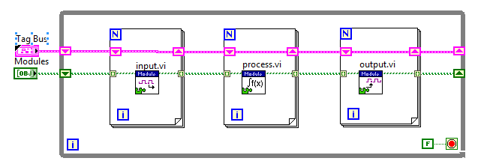
DCAF Engine - Simplified
Editor
Engine
Modules
Notes:
A simplified look at the engine.
The engine calls all the modules’ Input VIs, then all the Process VIs, and finally all the Output VIs.

Slide 14
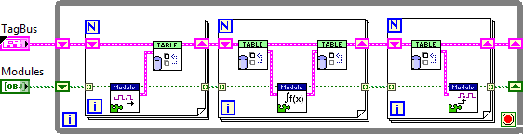
DCAF Engine - Simplified
Editor
Engine
Modules
Notes:
A slightly less simplified look now that demonstrates that the modules do not talk to each other directly. Instead, each one reads and writes to the Tag Bus table. The Tag Bus then ferries the data to the other modules.

Slide 15
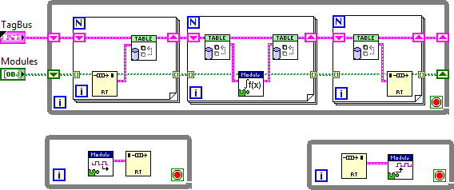
DCAF Engine - Asynchronous Modules
Editor
Engine
Modules
Notes:
While all modules are called in order, they do not all need to execute fully if they are marked as Asynchronous. Instead, the engine creates an extra loop and an RT FIFO – when the engine gets to calling the particular method it reads and writes to an RT FIFO instead

Slide 16
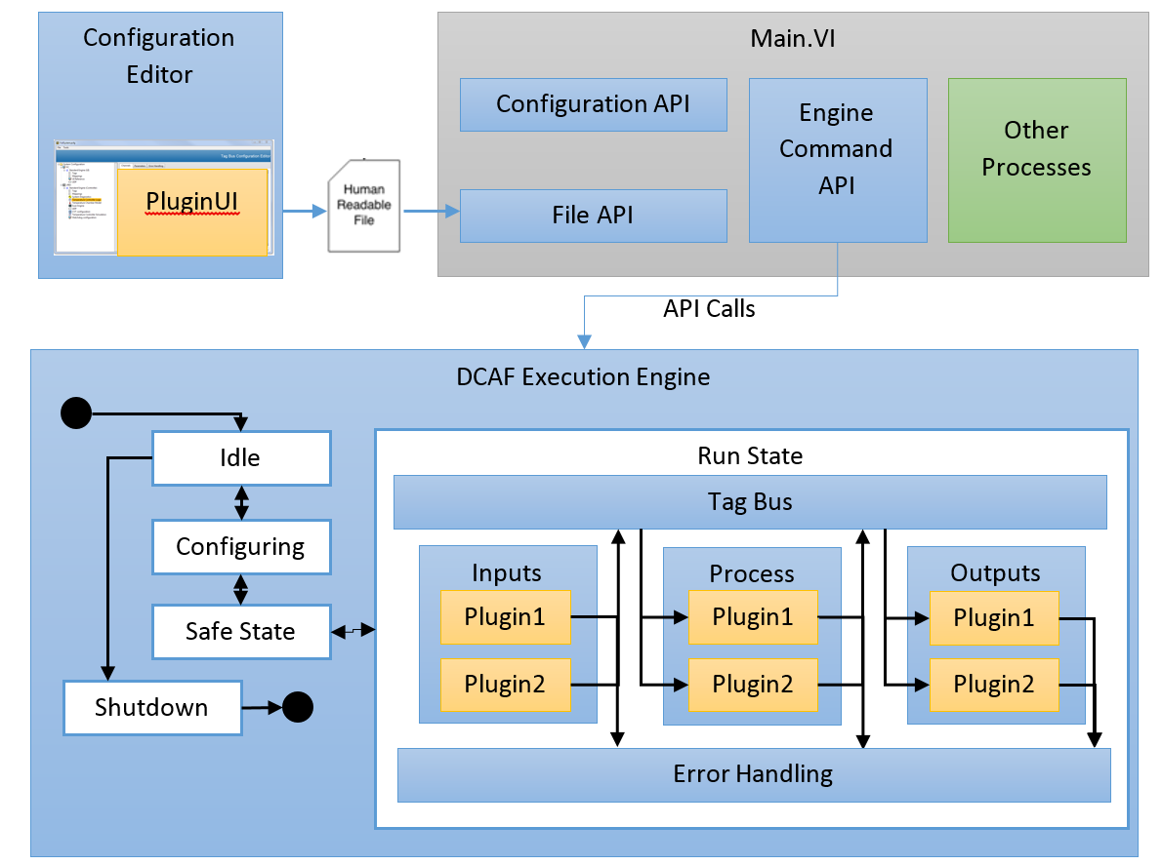
DCAF Engine
Blue: Provided out of the box
Yellow: Modules to customize behavior
Green: Parallel to the framework
Editor
Engine
Modules
Notes:
But what exactly is provided out of the Box?
The Engine runs the modules as we have previously seen, but this requires no direct user programming. Instead
State machine with a safe state
Sequentially executes Input, Process, and Output methods of each plugin
Passes latest value data between plugins
Configurable execution timing
Built-in error reporting and recovery
Prevent Race conditions, memory allocations, thread starvation, etc.

Slide 17

Engine Execution Model
DCAF Execution Engine
Run State
Shutdown
Idle
Tag Bus
Inputs
Process
Outputs
Upkeep
Wait
Configuring
Plugin1
Plugin3
Plugin1
Fault Recovery
Plugin2
Plugin4
Plugin5
House-Keeping
Safe State

Slide 18
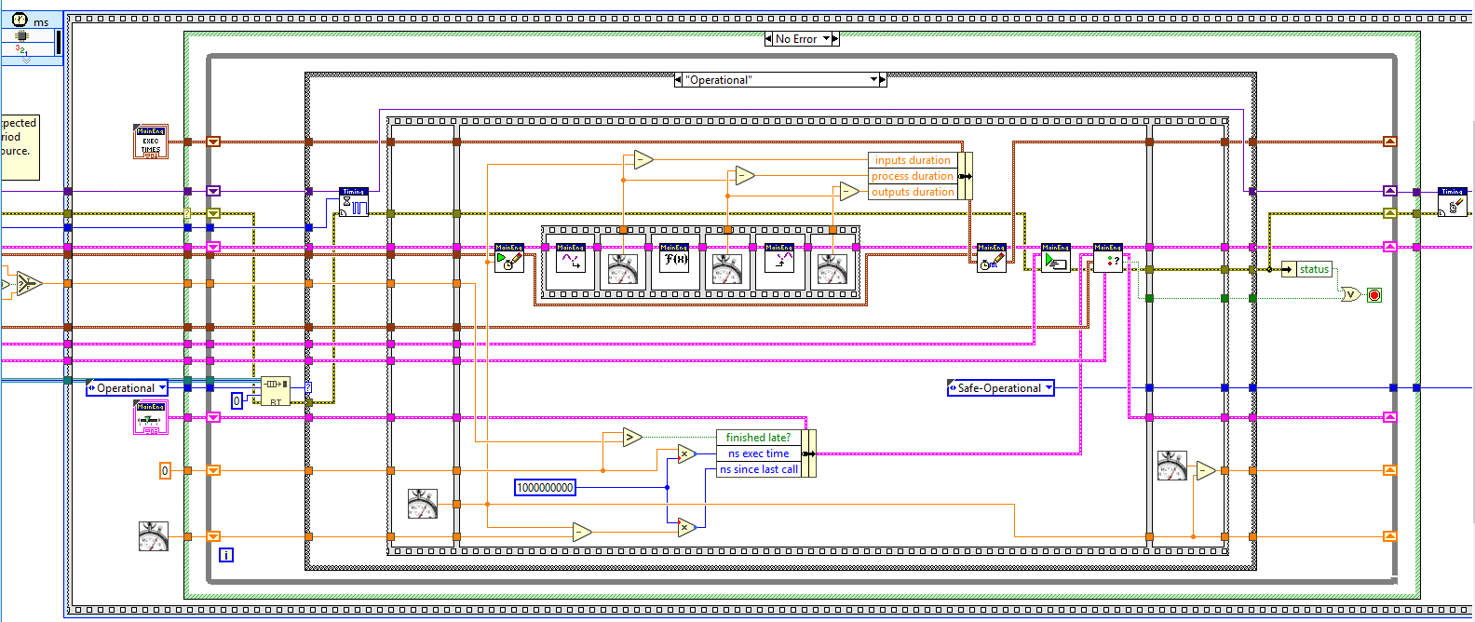
DCAF Engine - Execution
Editor
Engine
Modules
Notes:
The source code for the engine isn’t as scary as you might think. It follows a pretty straightforward sequence of steps:
Check for a message to stop.
Wait for next clock source to fire.
Sequentially read all inputs and store data on the bus.
Process data and store on bus, then process again and store on the bus, then process again. Etc.
Send data to all output locations sequentially.
Choose which plugins execute on the next iteration.
Check for errors and handle them.
Sequential execution provides predictable behavior.
C:\Program Files (x86)\National Instruments\LabVIEW 2017\vi.lib\NI\DCAF\Engines\Standard Engine\Execution Engine\main engine\primary control loop.vi

Slide 19
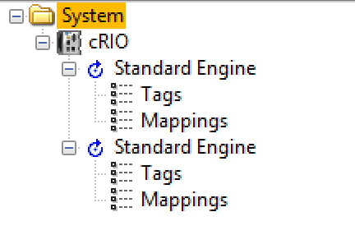
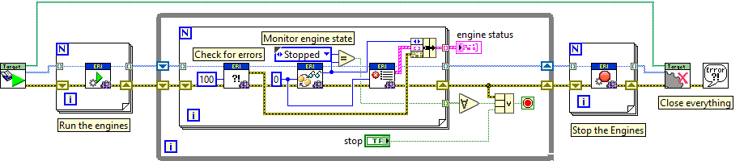
DCAF Execution Engine Interface
Can execute multiple engines at the same time
Each Engine is a different thread
Engine controls modules execution and data transfer
Provides API to control and get access to the engines

Slide 20
DCAF Engine - Execution Interface
Can execute have multiple engines at the same time
Each Engine is a different thread
Engine controls modules execution and data transfer
Provides API to control and get access to the engines
Editor
Engine
Modules

Slide 21
DCAF Engine - Asynchronous Modules
Editor
Engine
Modules
Notes:
While all modules are called in order, they do not all need to execute fully if they are marked as Asynchronous. Instead, the engine creates an extra loop and an RT FIFO – when the engine gets to calling the particular method it reads and writes to an RT FIFO instead

Slide 22
Asynchronous Module
Engine
Engine
Wait 0 ms on Input Buffer
Get DVR
Polling
Lock DVR
Transfer Data
Write DVR to
Command FIFO
Polling
Modules
Async Worker
Wait -1 on Command FIFO
Get DVR
Blocking
Lock DVR
Run Module Input
Write DVR to
Input Buffer
Blocking
Editor
Engine
Modules
Notes:
There is no data transfer, the only thing we are transferring is the DVR. We are using the FIFOs as a arbitration mechanism to protect the DVR. This is required because DVR, will always block and there are no timeouts.

Slide 23
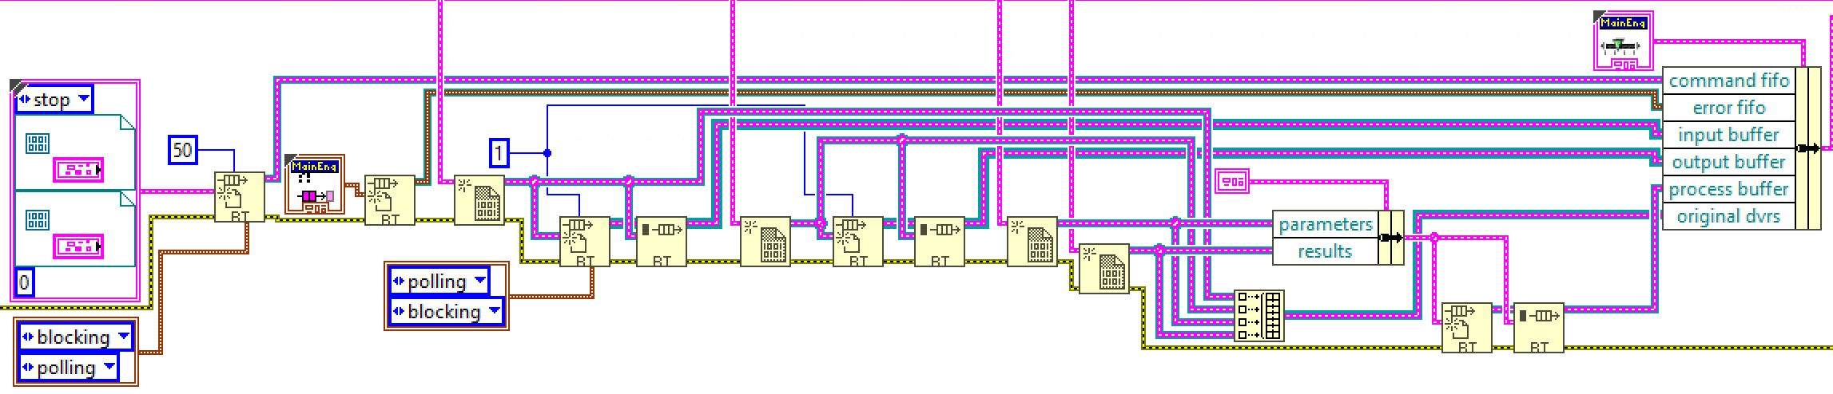

Asynchronous Modules
Creates DVRs
Creates RT FIFOs
Command FIFO
Input, Output and Process Buffer
Launches Asynchronous Worker
Editor
Engine
Modules
Notes:
C:\Program Files (x86)\National Instruments\LabVIEW 2018\vi.lib\NI\DCAF\Engines\Standard Engine\Execution Engine\async executor\start async worker.vi

Slide 24
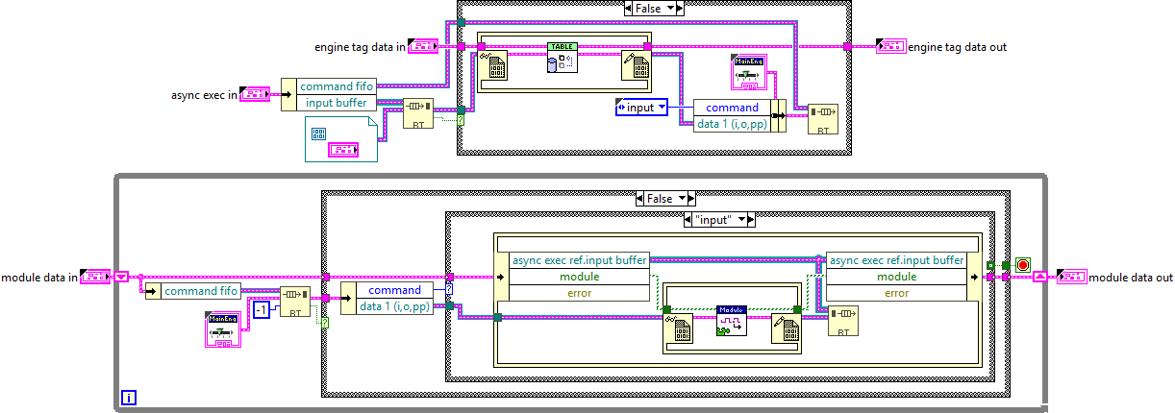
Asynchronous Module
Editor
Engine
Modules
Notes:
C:\Program Files (x86)\National Instruments\LabVIEW 2018\vi.lib\NI\DCAF\Engines\Standard Engine\Execution Engine\async executor\async input data method.vi
C:\Program Files (x86)\National Instruments\LabVIEW 2018\vi.lib\NI\DCAF\Engines\Standard Engine\Execution Engine\async executor\async worker process.vi

Slide 25
Modules

Slide 26
Module Components
Configuration
Created on PC, passed to runtime system
Provides data access and serialization/deserialization methods
Data storage only, no editor or runtime logic
Runtime Node
Initializes runtime based on configuration
Provides execution logic
Configuration
Editor node
Runtime
Editor
Engine
Modules

Slide 27
Module Components
Editor Node
User interface
Runs on PC
Creates or modifies the configuration
Contains the configuration class
Configuration
Editor node
Runtime
Editor
Engine
Modules

Slide 28
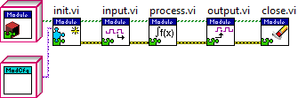
Module Runtime
Editor
Engine
Modules

Slide 29
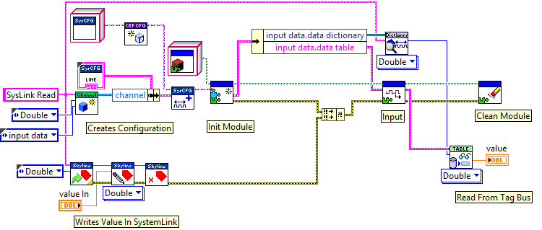
Module Runtime Test Harness Example
Editor
Engine
Modules
Notes:
Add compare between expected and read values to demo test

Slide 30
What is the module doing?
Engine
Input
Process
Output
Outside
Outside
Outside
Editor
Engine
Modules

Slide 31
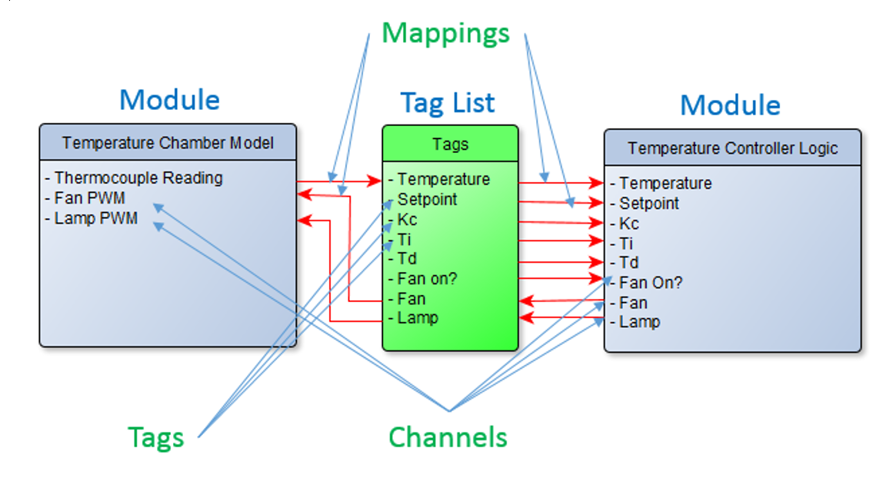
What is the module doing?
Editor
Engine
Modules

Slide 32
Static Module
Configuration Class
Select module options (number of instances, allowable targets)
Update validate.vi with validation rules
Update get default error list.vi with default error classifications
Editor Class
Select module glyph
Runtime
Implement User Input.vi, User Process.vi, and/or User Output.vi with custom logic
Editor
Engine
Modules

Slide 33
Dynamic Module
Configuration:
Add parameters to the Window
Add parameters to Configuration Class
Implement To and From String
Editor Class
Define Lines to tie Channel information to Module behaviour
Runtime
Implement User Input.vi, User Process.vi, and/or User Output.vi with custom logic
Editor
Engine
Modules

Slide 34
Configuration Editor

Slide 35
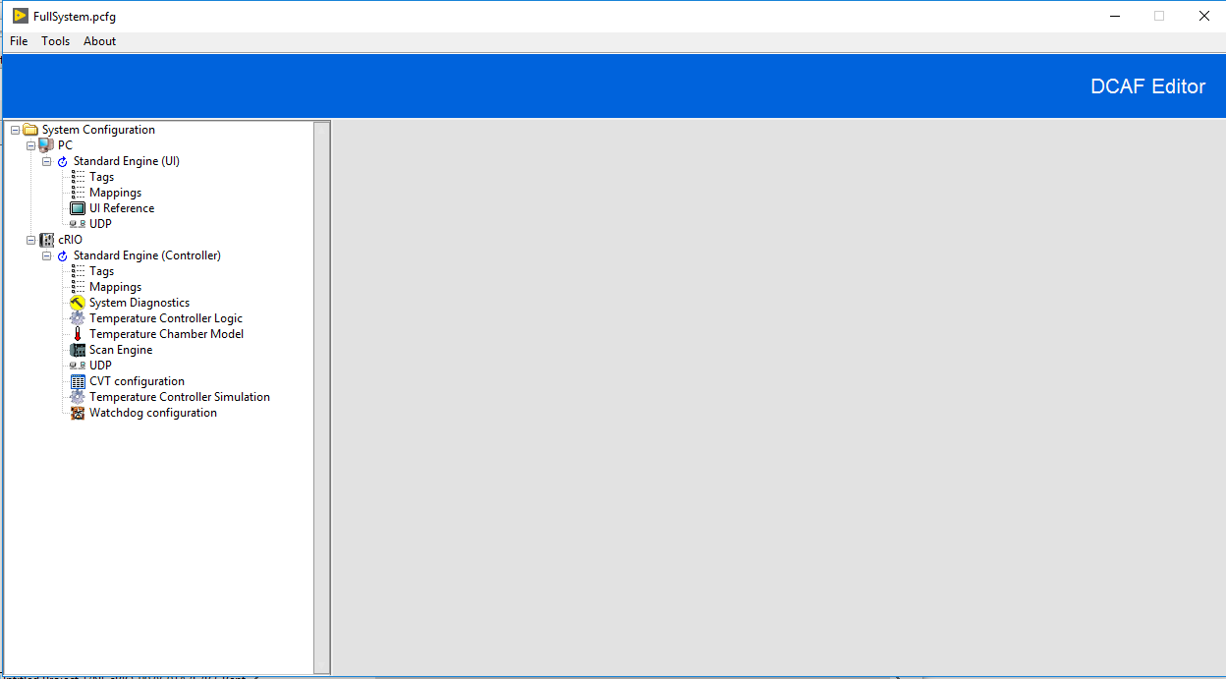
Configuration Editor Framework (CEF)
Open Source Library
Tools to manage tree control and subpanels
Can be extended and customized
3 starting templates available
Editor
Engine
Modules

Slide 36
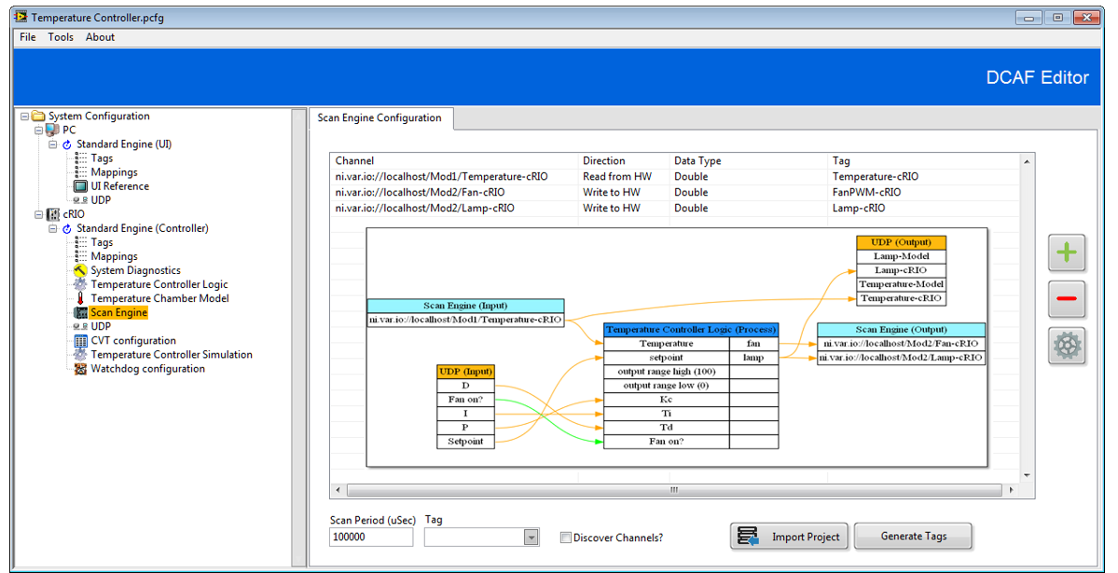
Configuration Editor Framework (CEF)
Editor
Engine
Modules

Slide 37

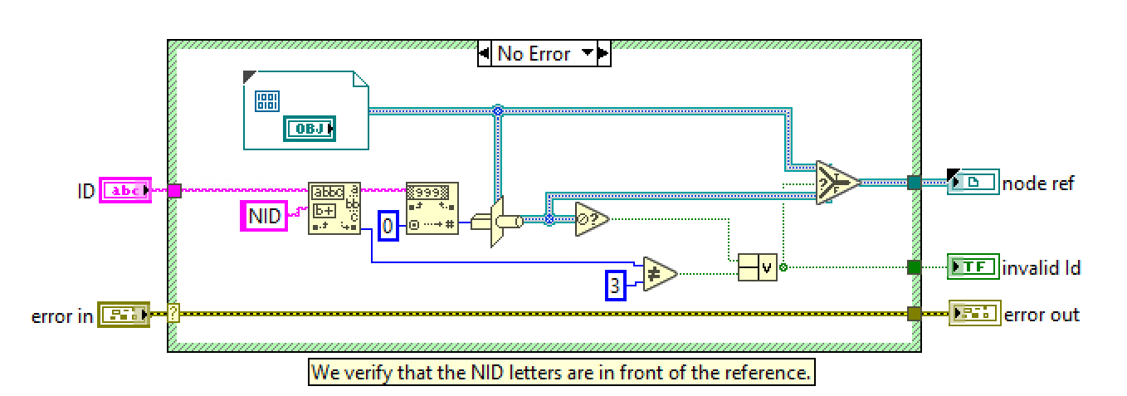
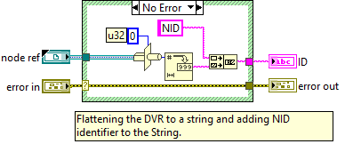

Text to objects DVR
This Feature is from CEF (Configuration Editor Framework)
Allows accessing objects from a string store on a tree

